Slide 1

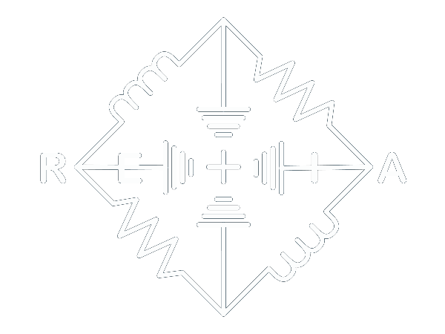
Mesh Networks For Beginners
Set Up Your First Meshcore & Meshtastic Node!

Slide 2

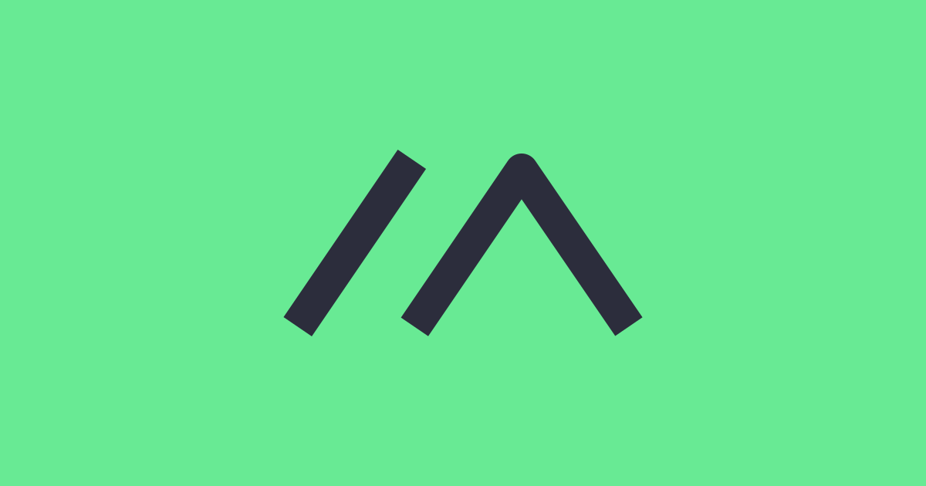
What are we learning today?
Common & custom types of LoRa Nodes
Legal & practical considerations
LoRa & Mesh networking fundamentals
Meshtastic vs Meshcore
How to set up new nodes for Meshtastic & Meshcore
Configuring settings to join local community nets

Slide 3
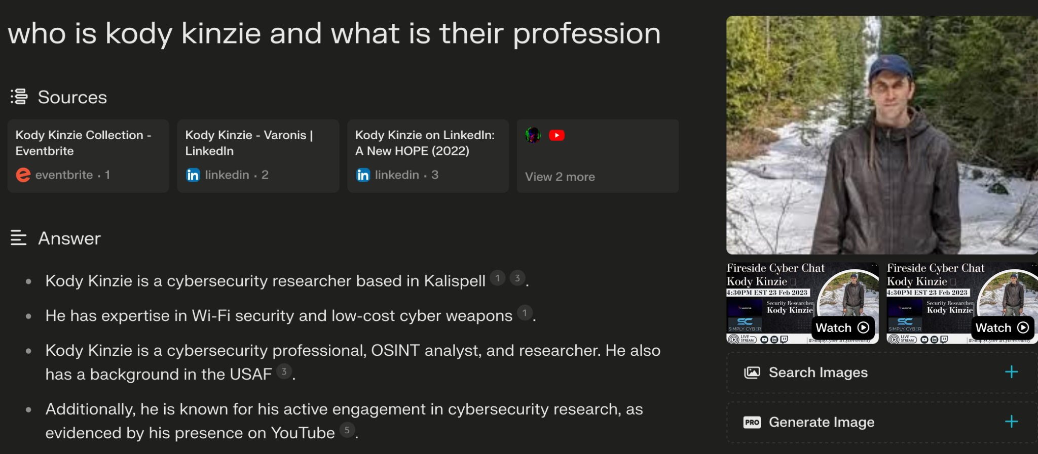
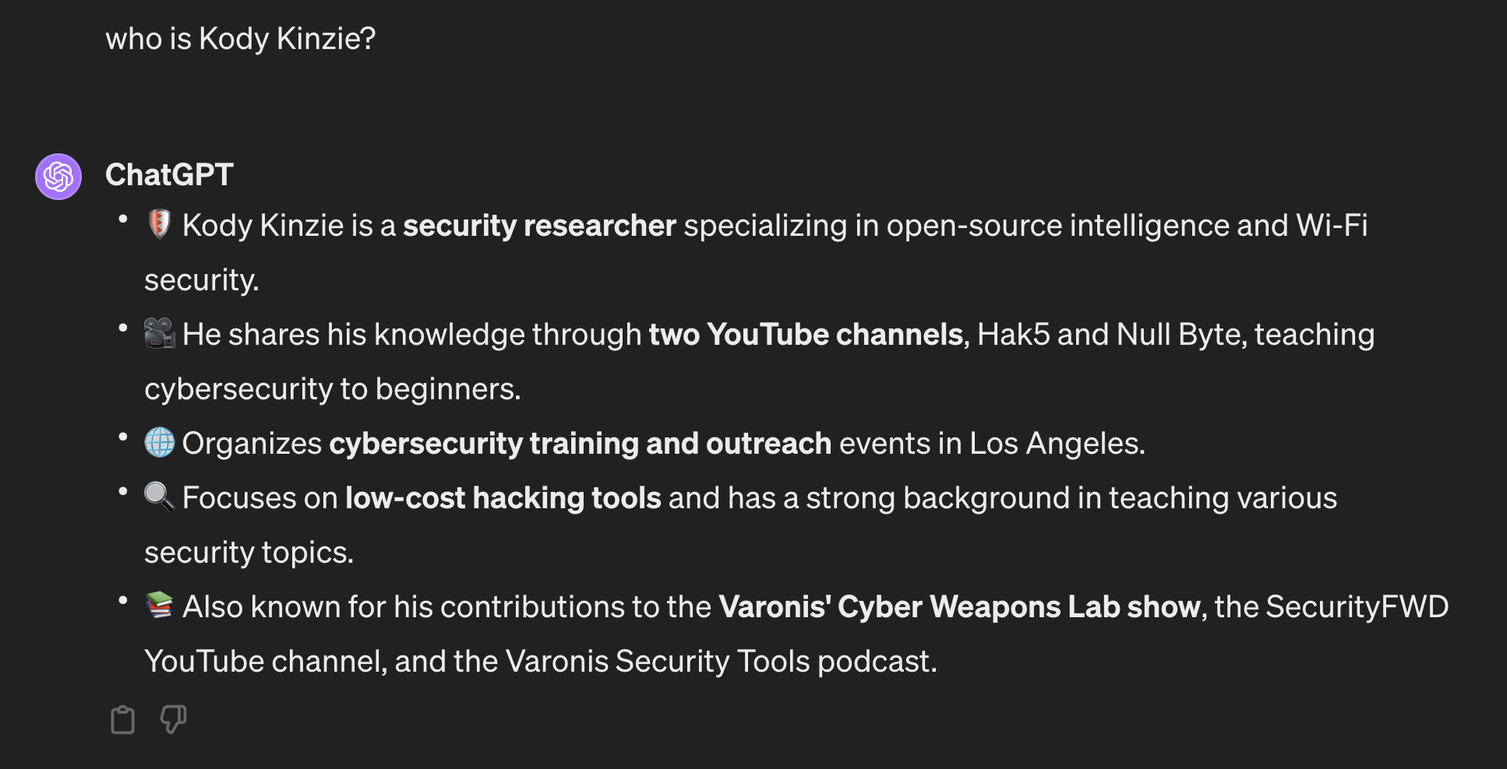
Who Am I?
Bonsoir! I’m Kody.
You can find me at www.hack.gay
I’m a security researcher who focuses on Wi-Fi and LoRa hacking, digital investigations, and electronics.
I love teaching people how to get started with ethical hacking in person and on my YouTube channels:
Retia
Null Byte

Slide 4
What is the point of Mesh Networks?
Bidirectional, encrypted off-grid communication over long distances
Amplified by nearby nodes, regional networks can span 200+ miles
Monitor sensors, track objects, control hardware remotely
Robust communication in areas with congested or nonexistent infrastructure
Ultra-low cost hardware makes nodes disposable

Slide 5
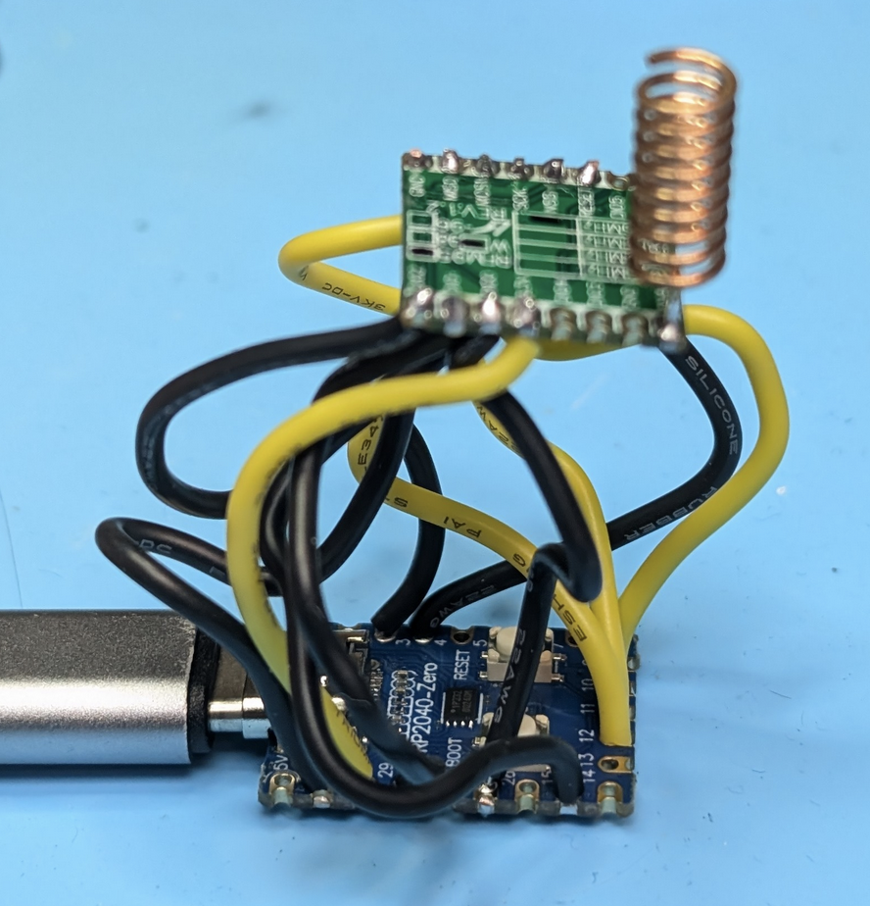
What is the cost of participating?
You can make your own horrible nodes for $5
$70-$90 for a fancy node from China
$120+ for ruggedized, fully featured nodes

Slide 6
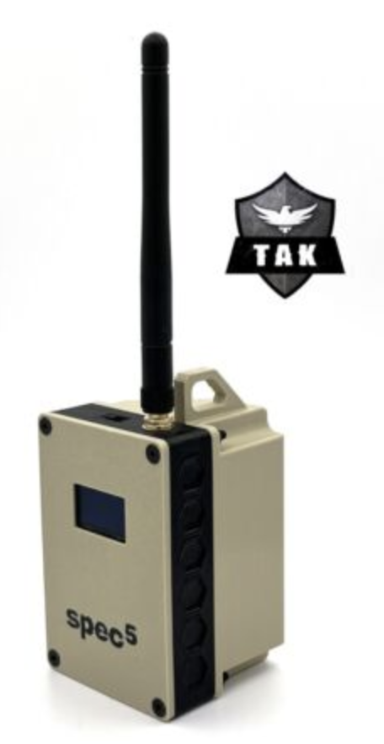
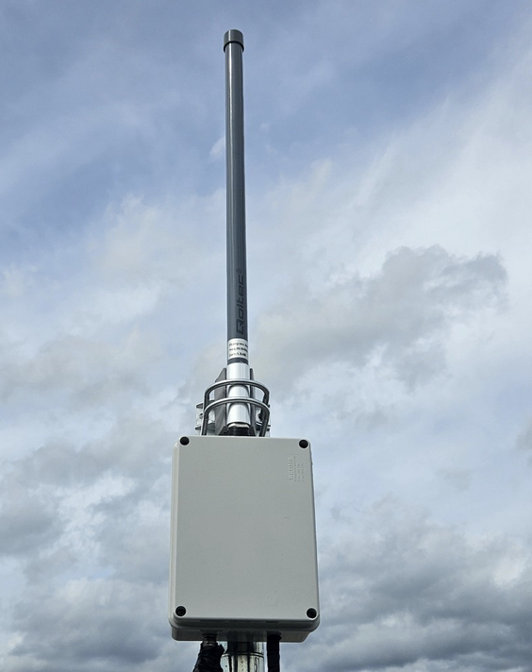
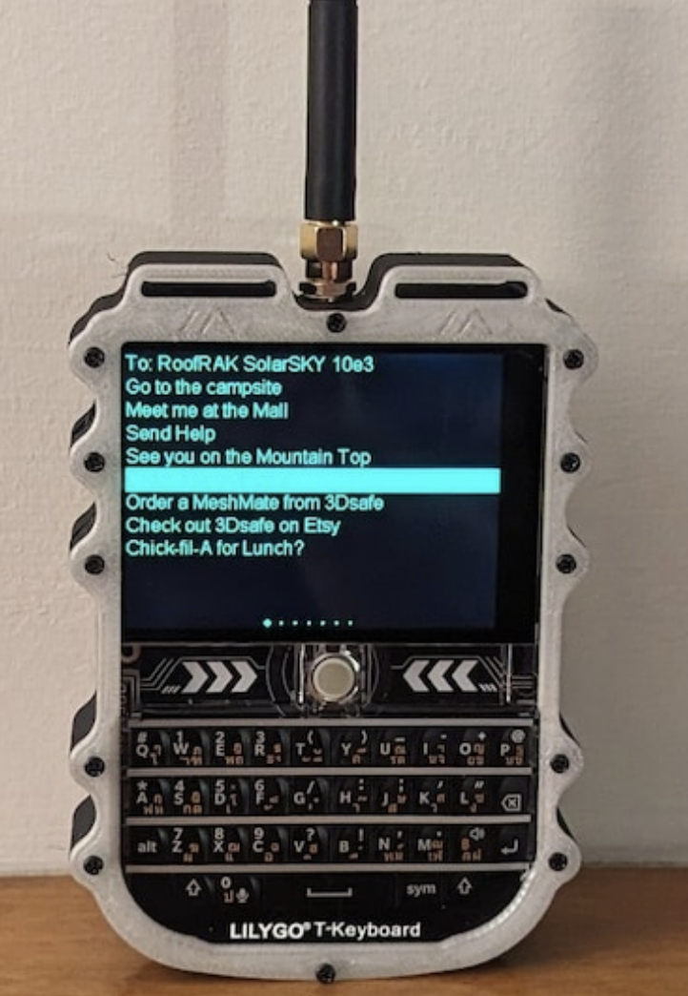
What can we make with this?
Off-grid chatting between devices in remote areas (backwoods)
Communication in areas with congested service (concerts, raves)
Inter-vehicle communication (vehicles, boats, & aircraft)
Encrypted disaster/emergency response
Map and military intelligence sharing
Remote Sensor telemetry (presence, environmental)
GPS Tracking of moving nodes
Anti-satellite warfare resilience
Remote control of hardware: vehicles, ambient lighting, flashes

Slide 7
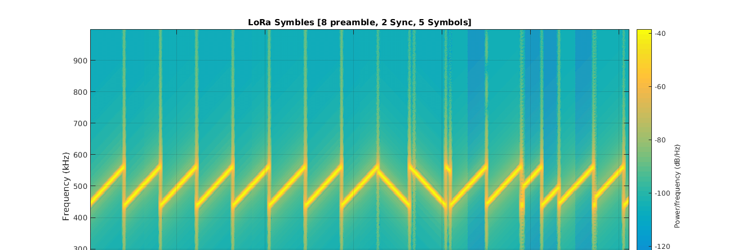
Defining Terms: LoRa Radio
LoRa - The long range radio standard we use to transmit, encoding data using up and down chirps

Slide 8
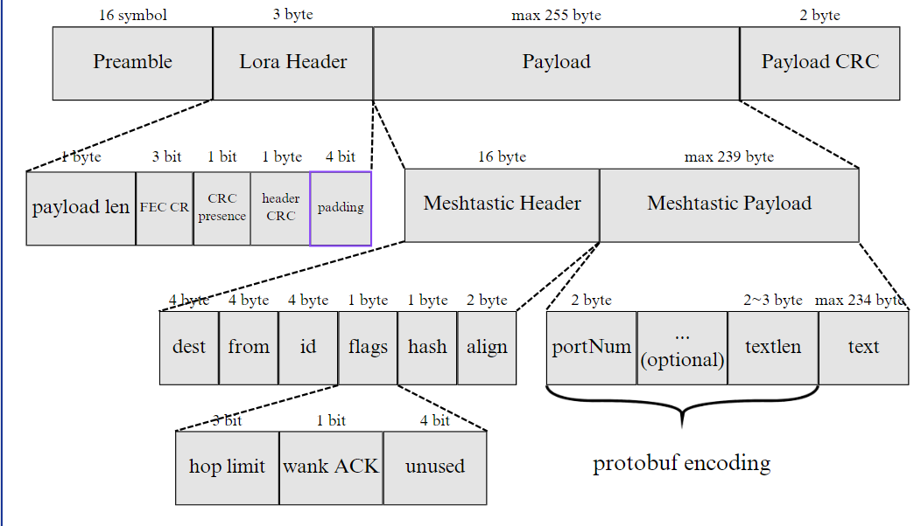
Defining Terms: Meshtastic
Meshtastic - A protocol, with packets sent over LoRa, that allows for encrypted mesh networking primarily at Layer 3 (Network Layer) of the OSI model

Slide 9
What is Meshtastic?
Meshtastic adds encryption, managed flood routing, & convenient apps to LoRa
Users control nodes via Bluetooth, Wi-Fi, or Serial connection
Managed with iOS, Android, MacOS or Windows apps
Can also connect via any chrome browser with WebSerial webapp!
Encrypts packets & removes headaches of matching radio settings

Slide 10
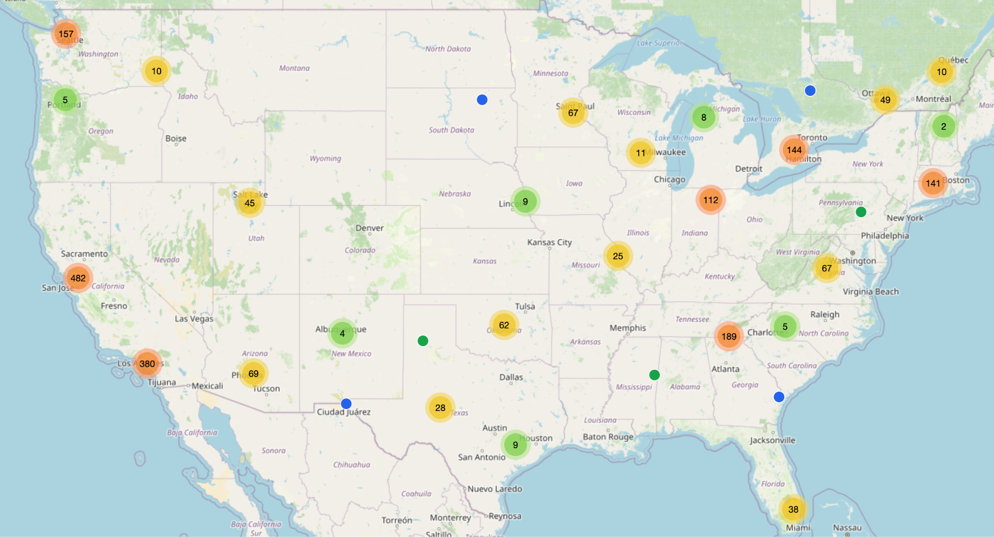
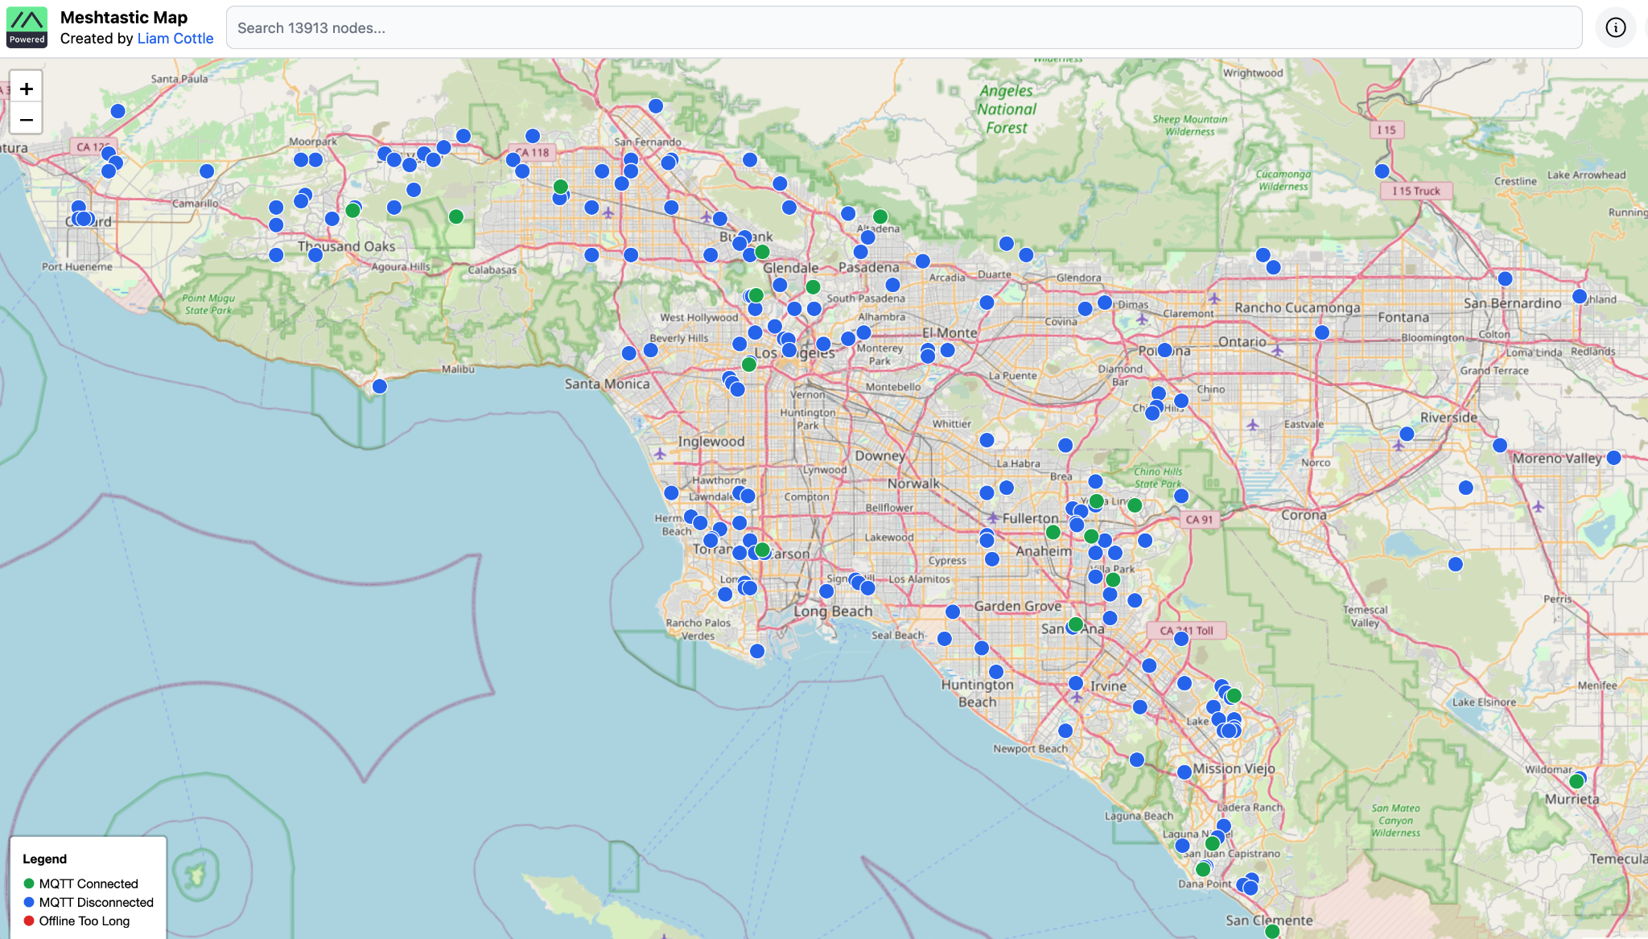
Real World Mapping
meshtastic.liamcottle.net
Uses local MQTT collectors
Collector nodes forward observed nodes over internet to the map via MQTT
Blind spots, but I can track location of nodes over time
Tracked my flight!

Slide 11
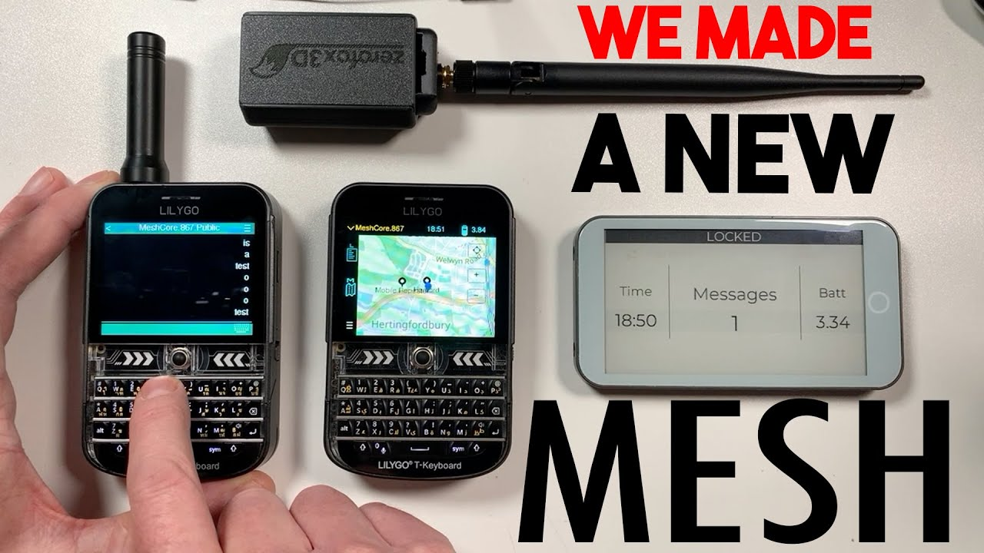
Defining Terms: Meshcore
Meshcore - Another Layer 3 protocol introduced in 2025, designed to be more scalable and allow for more reliable direct messaging than Meshtastic

Slide 12
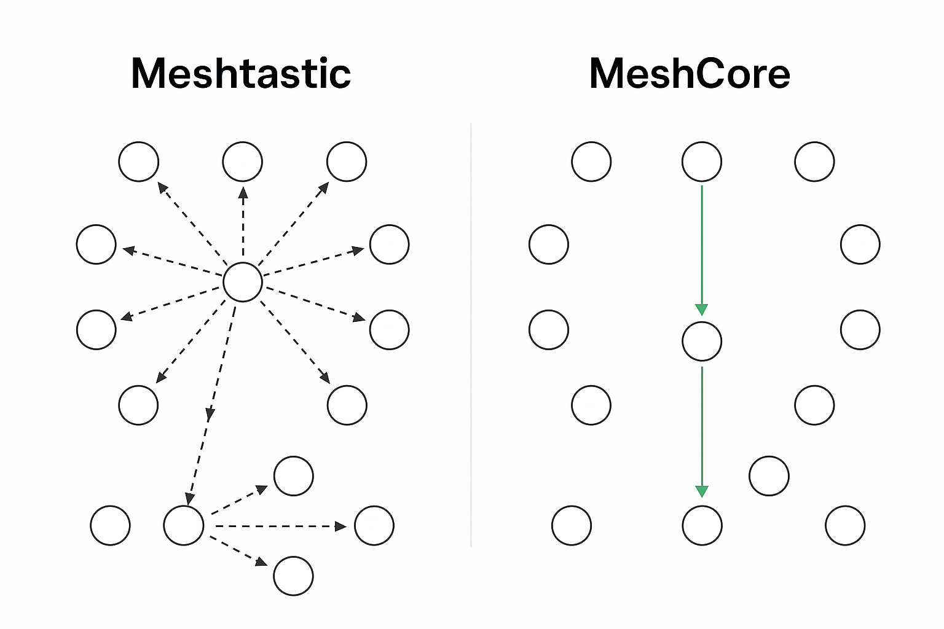
Meshcore Vs Meshtastic - Push vs Pull Telemetry
Meshtastic uses flood routing, all devices repeat traffic they hear by default
This is loud, many devices are transmitting and causes network traffic and congestion
Lots of unnecessary traffic in default networks
Maximum of 7 hops and no defined routes means low reliability for DM’s
Meshcore uses static routes, floods only when needed, only repeaters repeat packets they hear
Much more quiet because only repeaters send telemetry and repeat
Manually send adverts to be discovered
Remembering paths prevents unnecessary flooding and scales better

Slide 13
New on Meshtastic For 2026:
Meshtastic is using next-hop routing for DM’s!
Zero-hop (no penalty) repeat for routers to extend range
Configure all settings via buttons

Slide 14
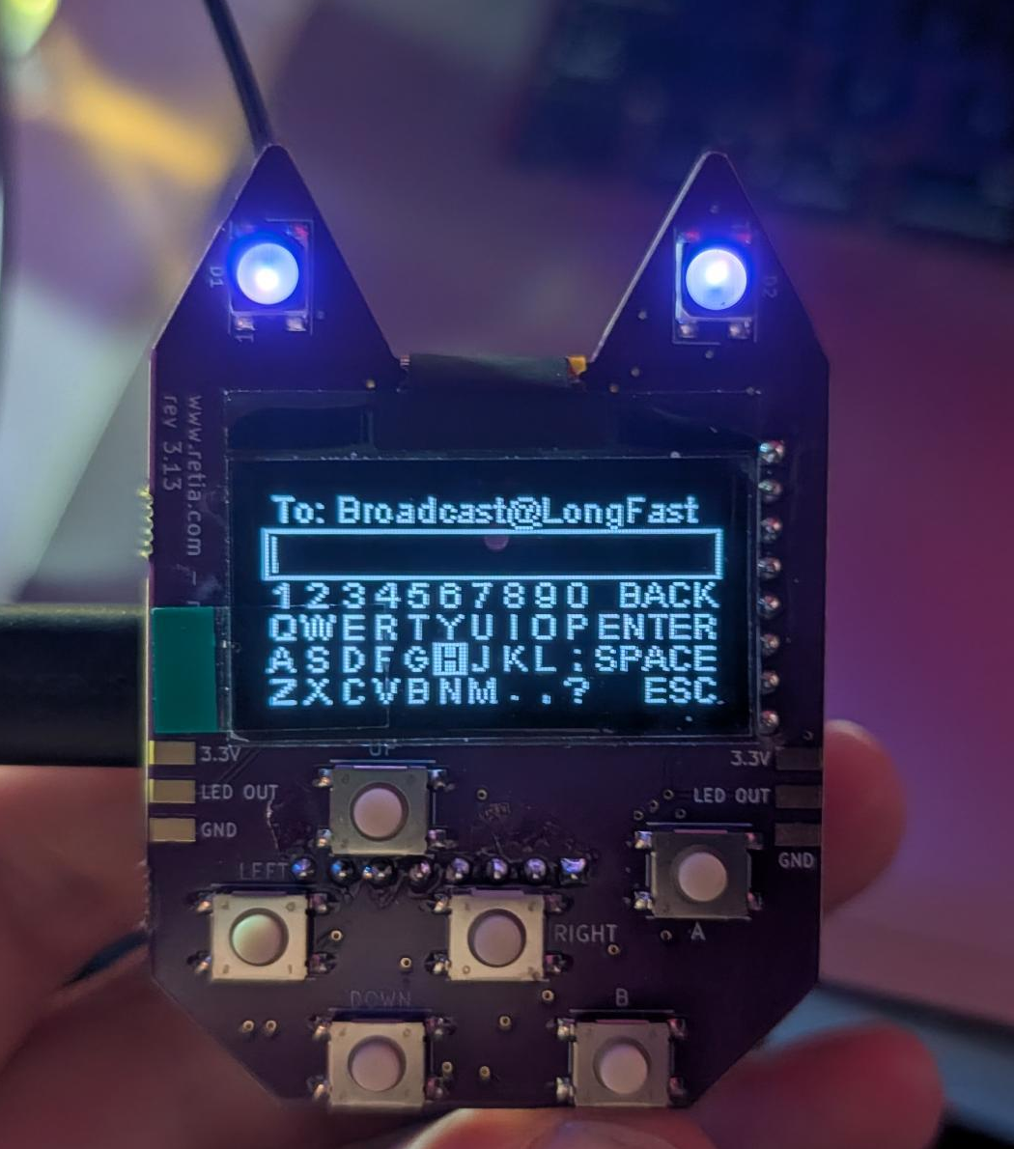
Hardware Fundamentals
Picking or building a node starts with understanding how they work!
Let’s go through what makes up a LoRa node

Slide 15
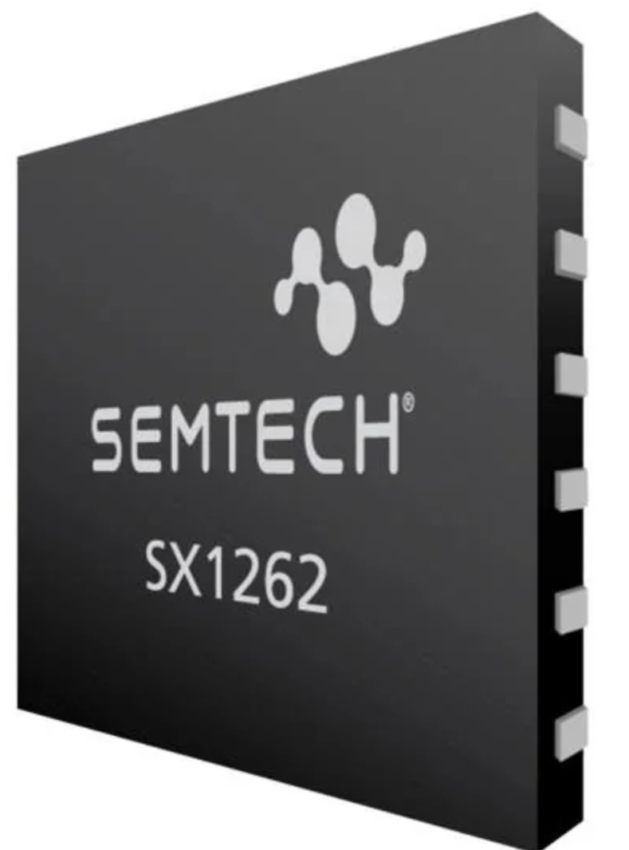
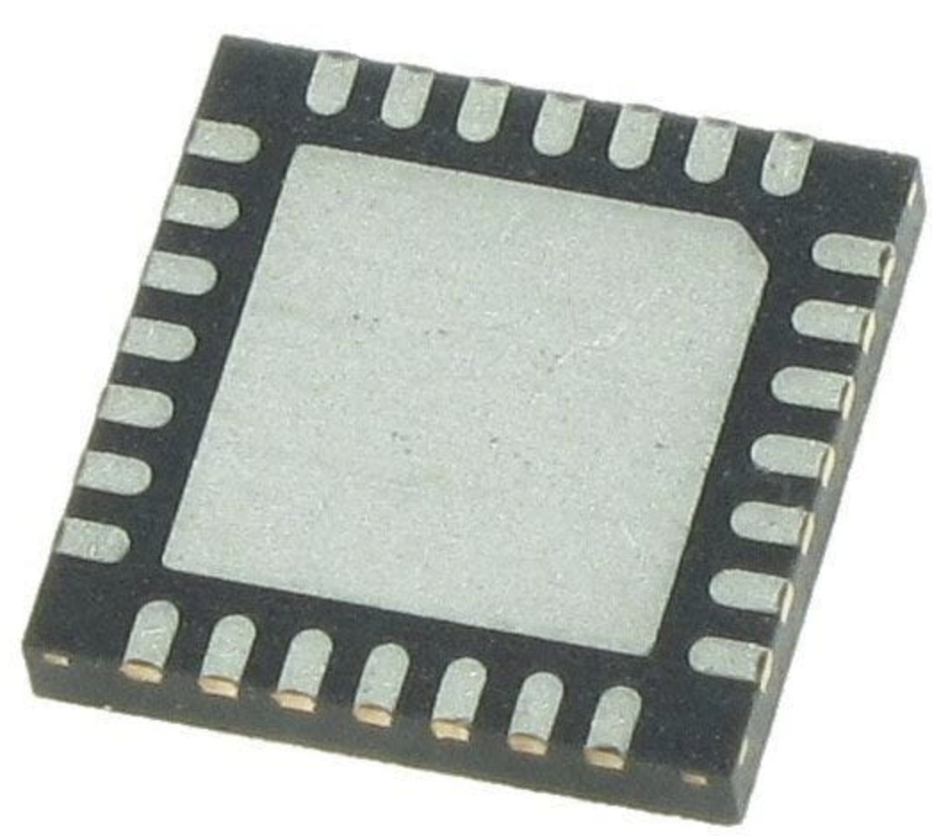
Defining Terms: LoRa Radio Chips
LoRa Chipset - The LoRa radio chip that controls radio transmission, such as sx1262

Slide 16
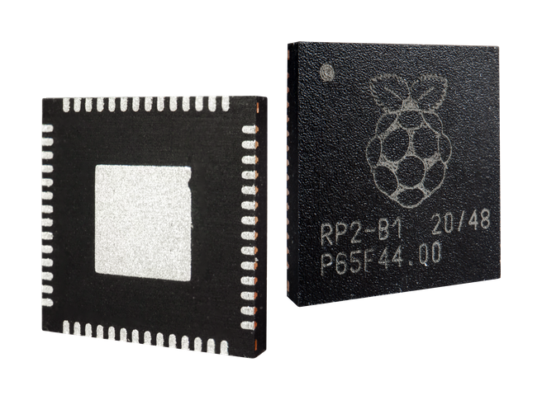
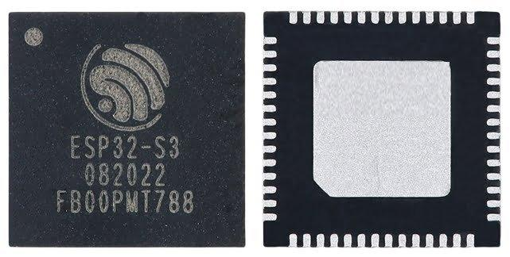
Defining Terms: Host Microcontroller
Host Microcontroller - The “brains” that run Meshtastic, handle Bluetooth, Wi-Fi, & Serial communication, & interface with external hardware

Slide 17
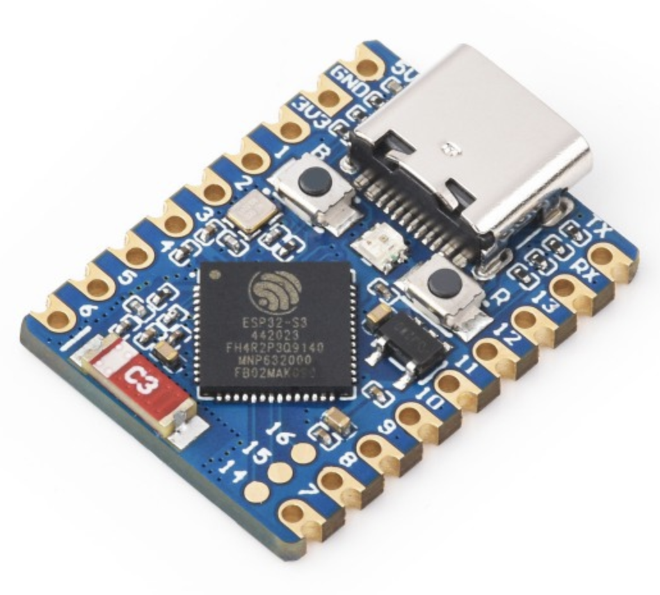
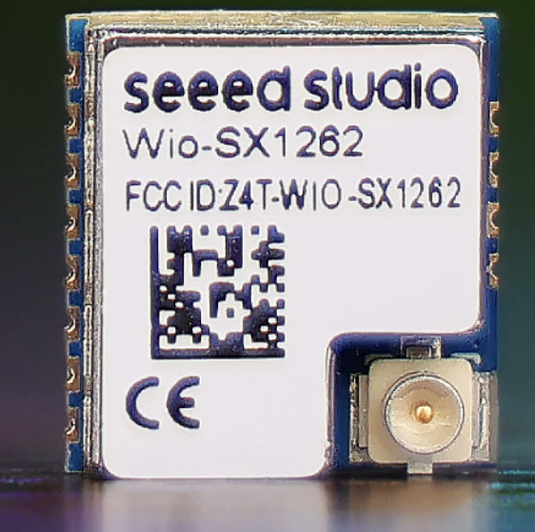
Defining Terms: Breakout Boards
Breakout board: An expansion board designed to make a bare host or radio chip more useful, breaking out pins & sometimes USB & power management

Slide 18
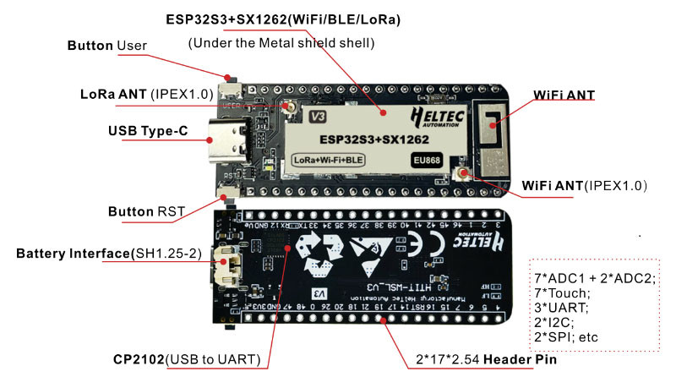
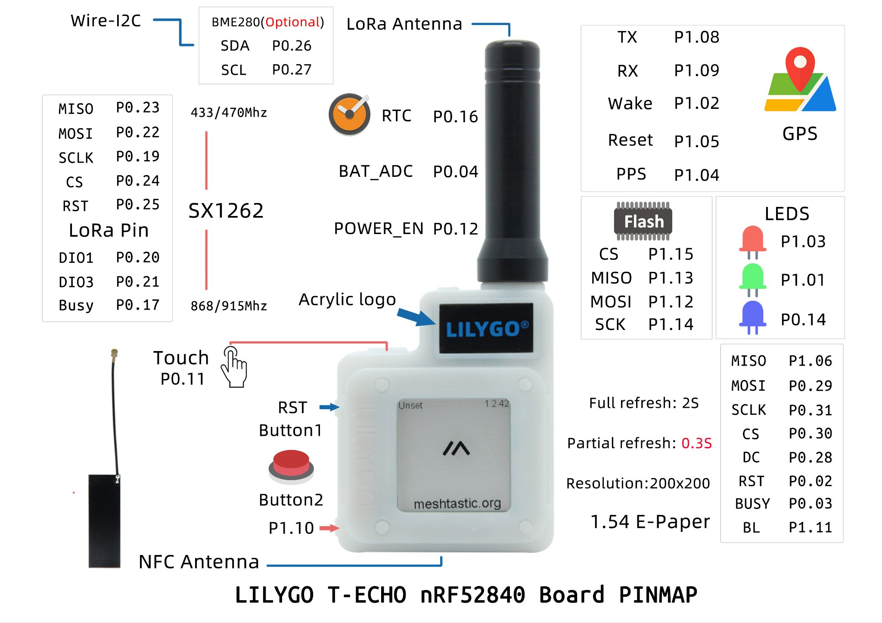
Defining Terms: Nodes
LoRa Node: A combination of LoRa radio & host microcontroller. Together, they can run Meshtastic or Meshcore!
Simple Node <-------------------> Complex Node

Slide 19
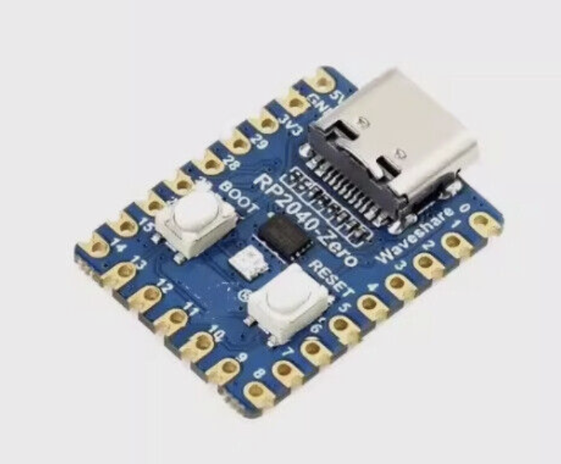
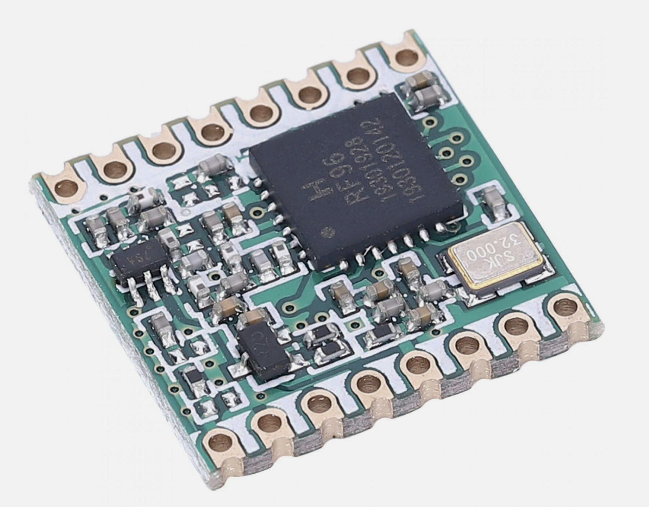
Host + Radio = Node
RP2040 Zero (host breakout) + RFM95 (radio breakout) = $5 Node

Slide 20
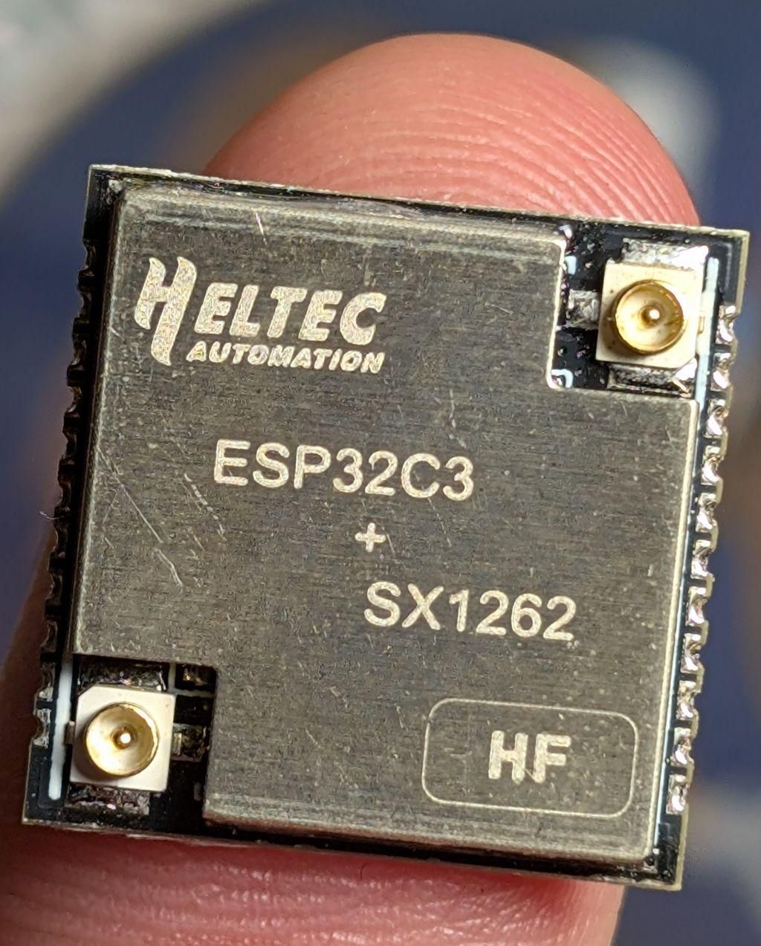
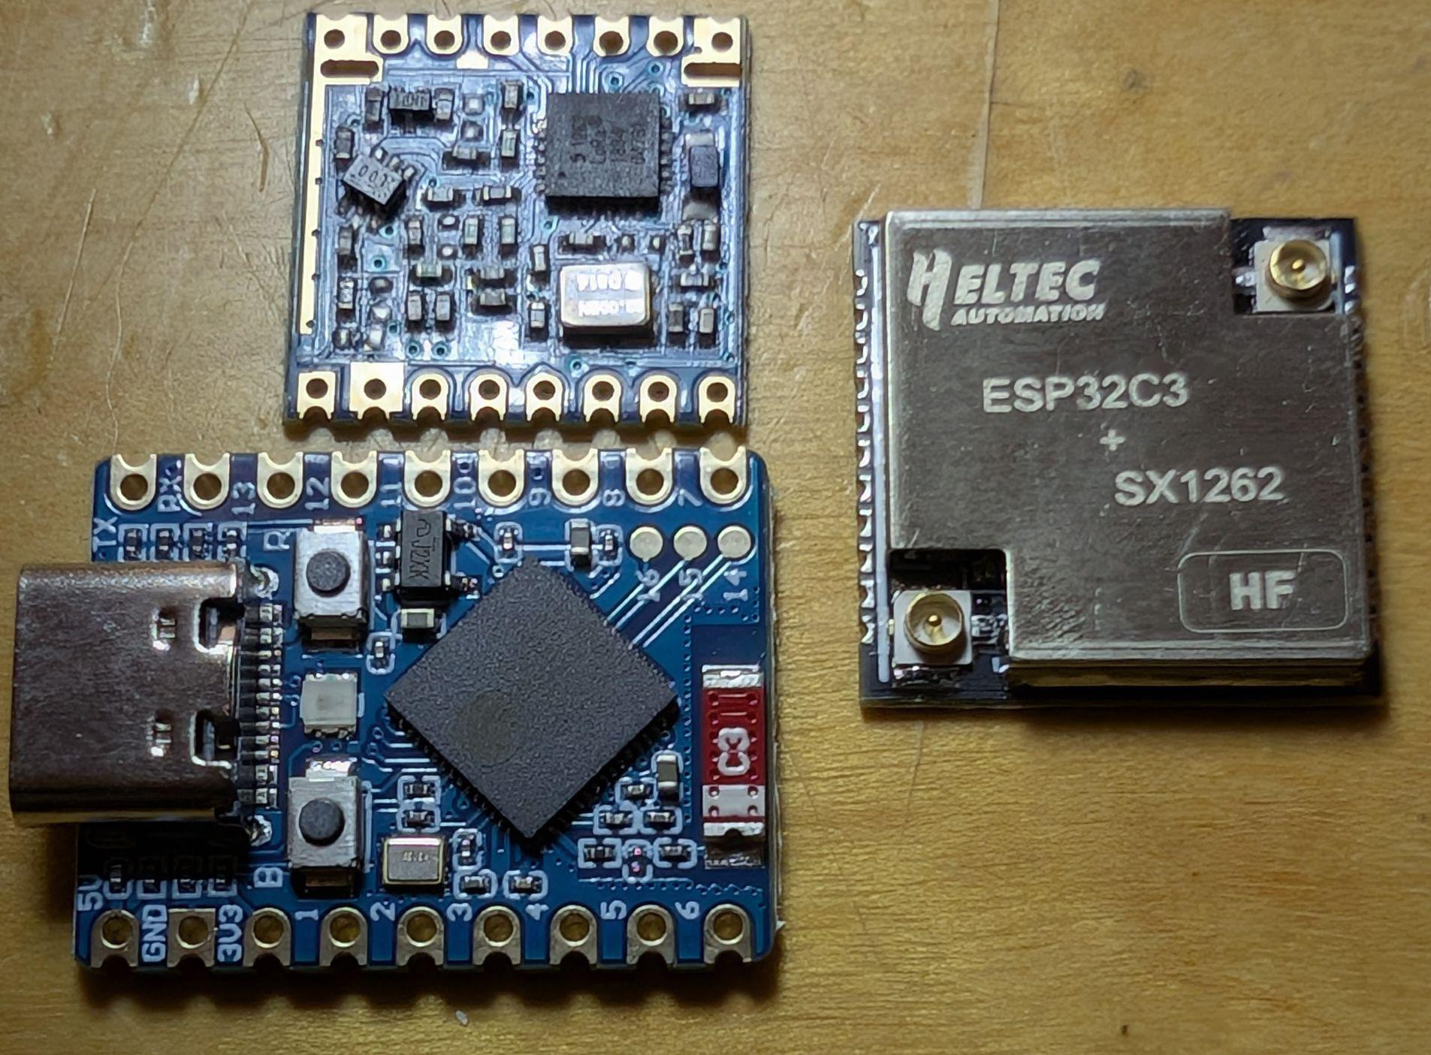
Future Nodes for $15

Slide 21
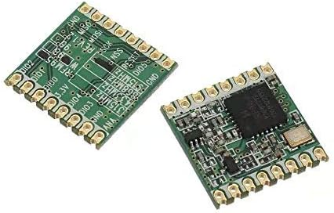
Introduction to LoRa
LoRa stands for Long Range, alternative radio standard
Radios that operate in unlicensed sub-GHz frequency bands
Slow data rates but very long range
Not for webcam monitoring, but ideal for telemetry, chat, control signals

Slide 22
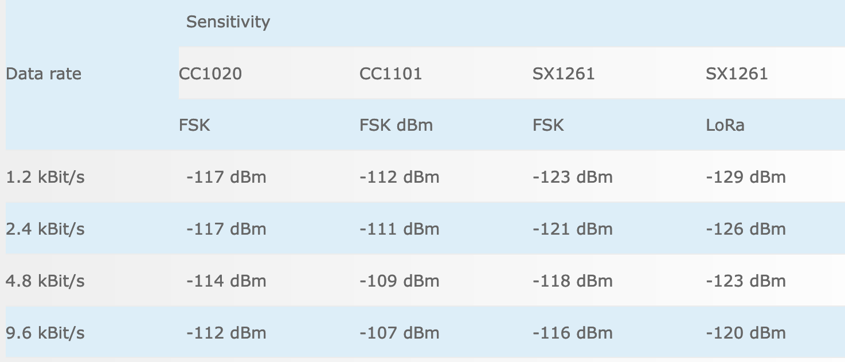
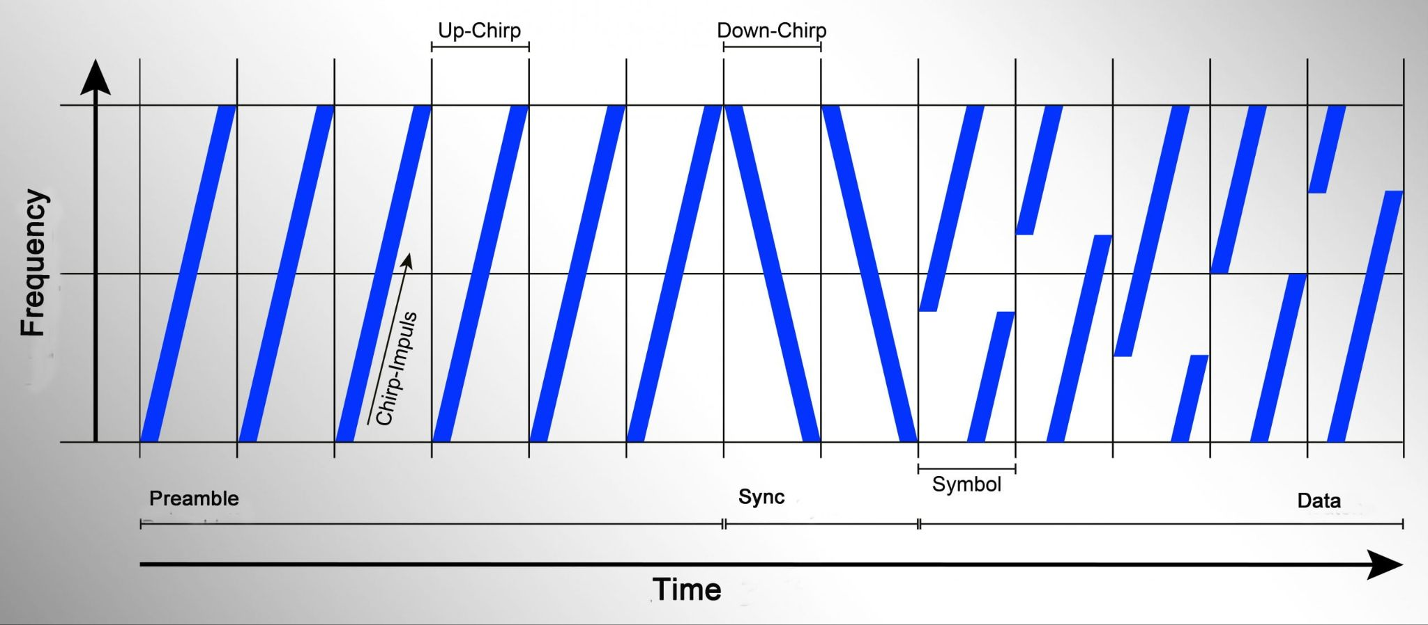
What makes LoRa special?
Long range protocol uses up and down “chirps” to send data
Chirp Spread Spectrum modulation helps packets survive noise & interference
Successfully receive & decode packets 20 dB below the noise level
Receiver sensitivity of a maximum of -149 dBm
Source: interline.pl

Slide 23
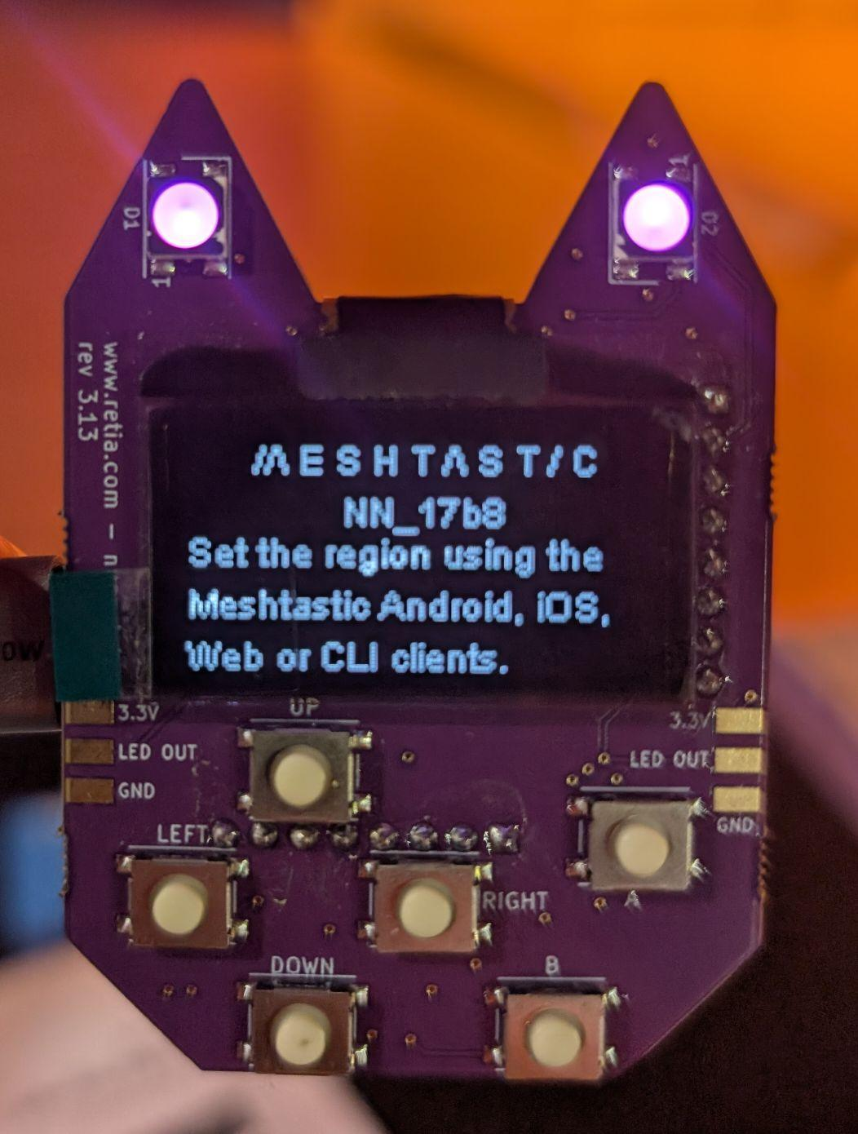
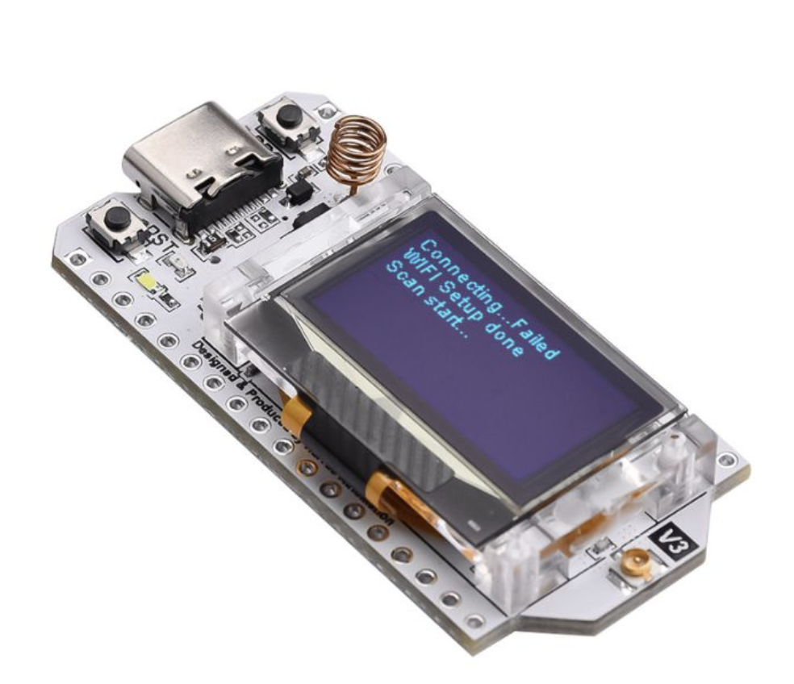
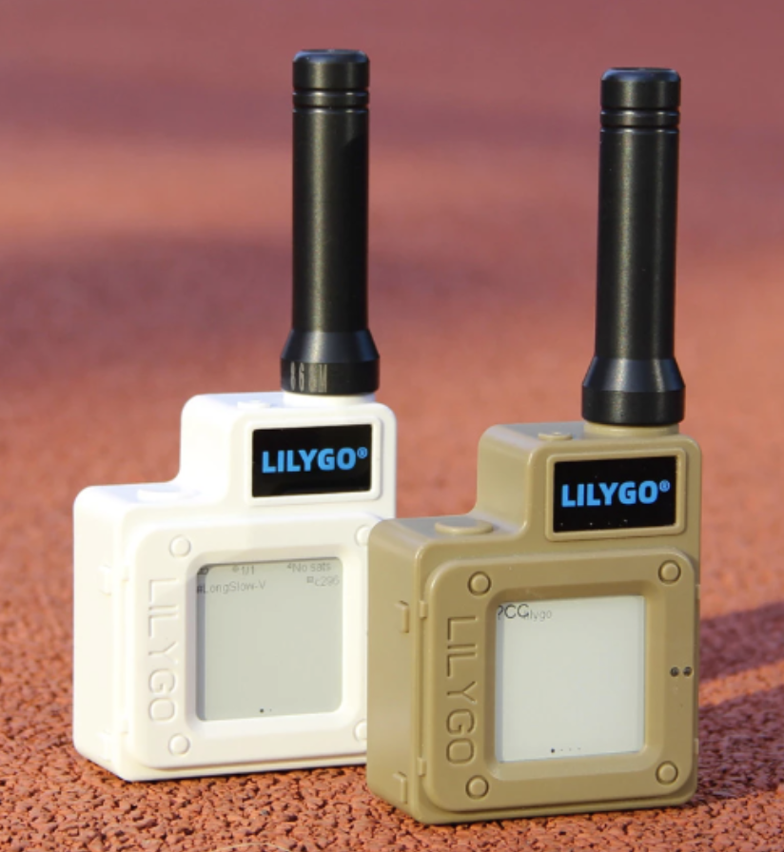
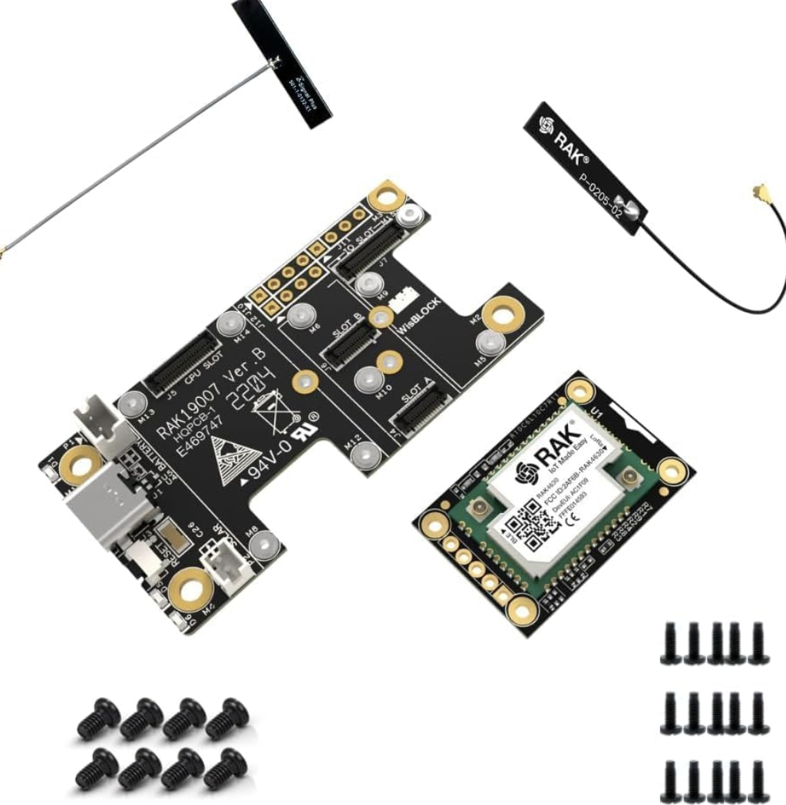
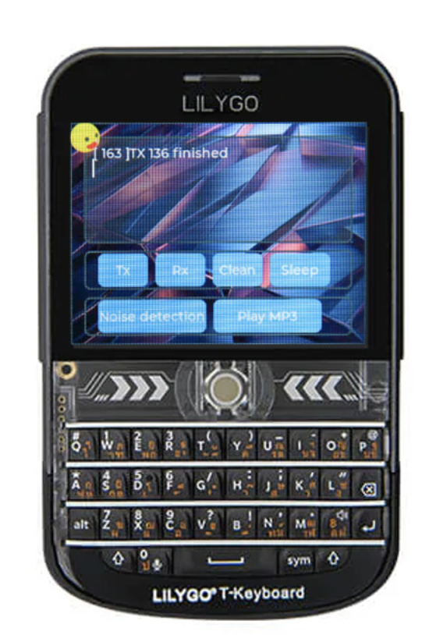
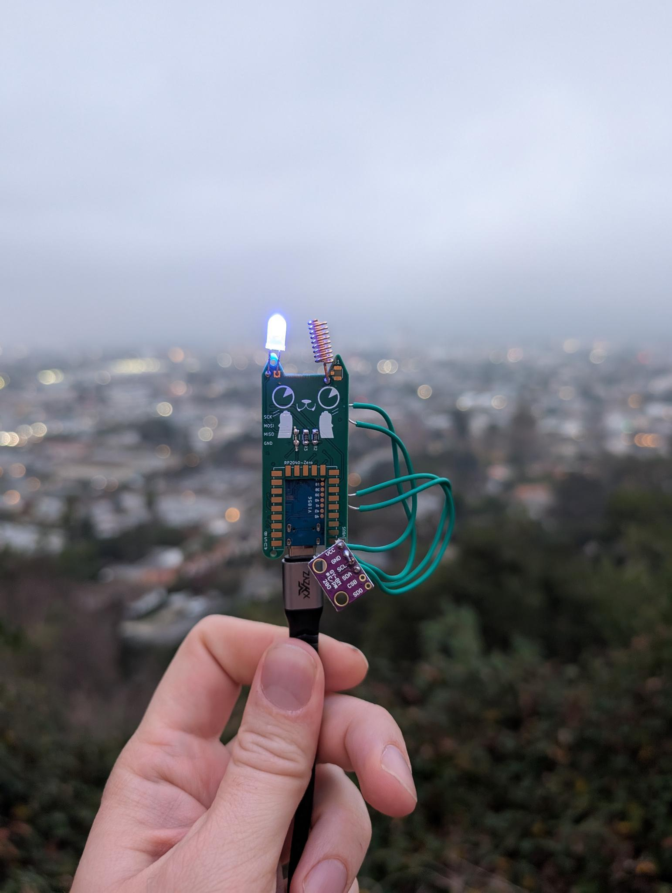
What other devices can I use?
Here are some of the usual suspects: Heltec v3, Lilygo T-Deck, Rak Wireless Wizblock,
Lilygo T-Deck, Nibble, Nugget

Slide 24
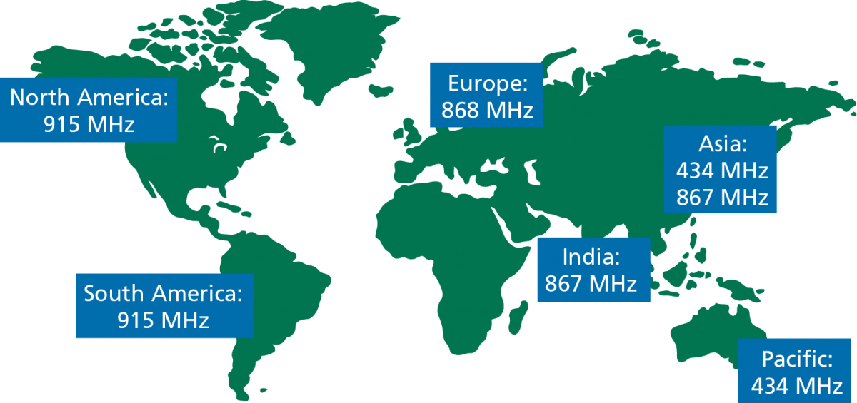
Regional frequencies - Check your radios!
image from https://lowpowerlab.com

Slide 25
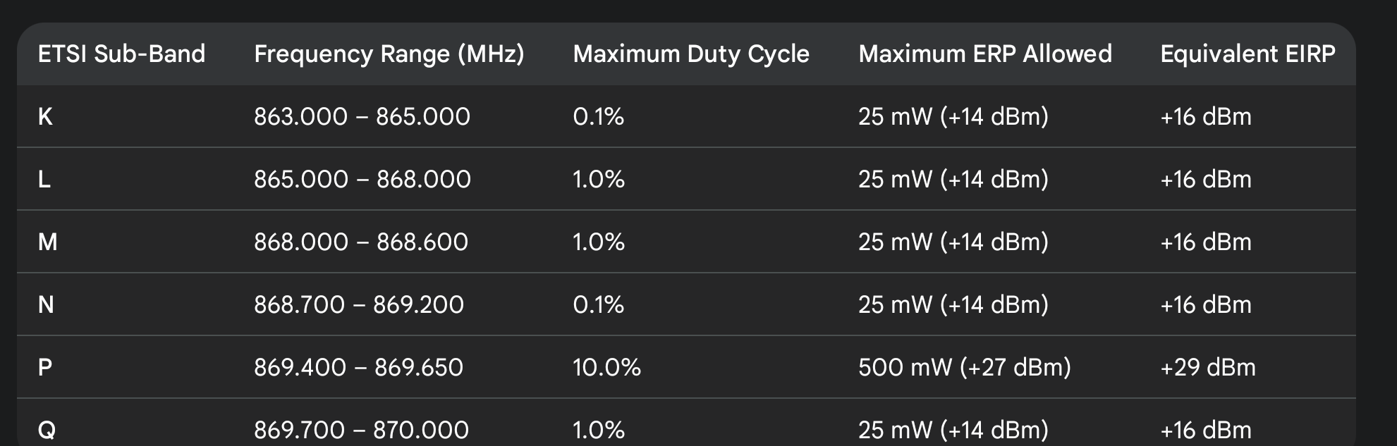
Duty Cycles

Slide 26
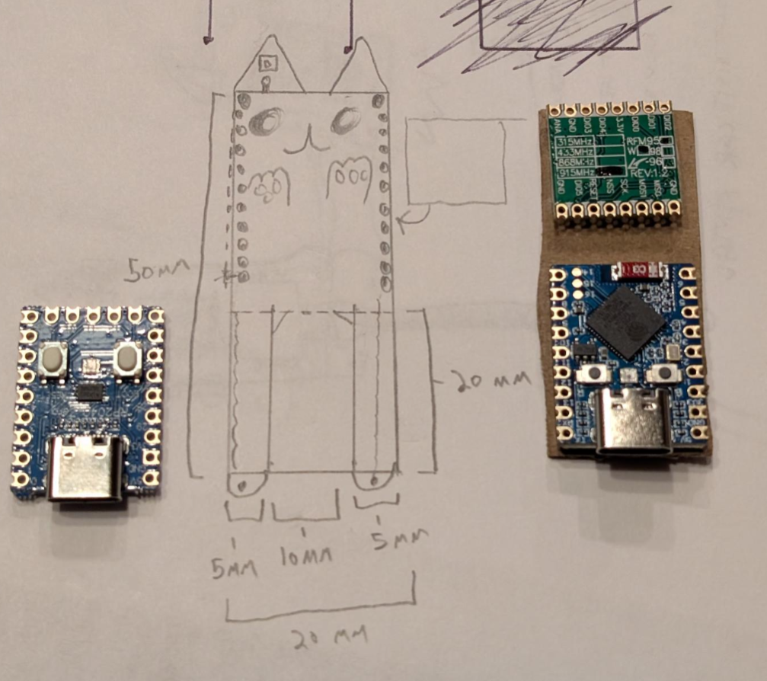
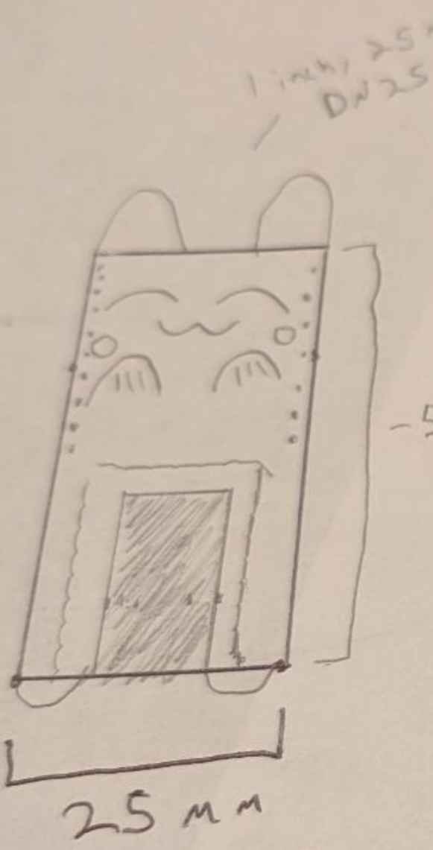
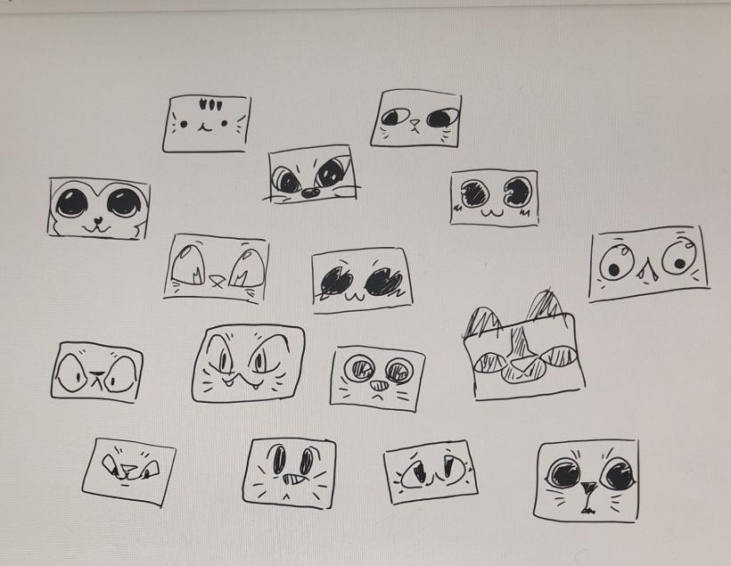
Making 300 Custom Meshtastic Kits: The Nibble

Slide 27
The Nibble - The Original Cat Meshtastic Node Kit
Combines RP2040 or ESP32s3 host with sx1276 radio
Designed to be soldered by beginners
Pick between RP2040 with serial only, or esp32s3 with Bluetooth & Wi-Fi
Designed to fit 1 inch PCV pipe for outdoor placement
Pads for adding SPI or i2c sensor chains like bme280
RP2040 version can’t connect to iOS over serial, but serial works on Android, desktop, & webapps
We made 300 Nibbles at c3!
Open Sourced at Hackers On Planet Earth

Slide 28
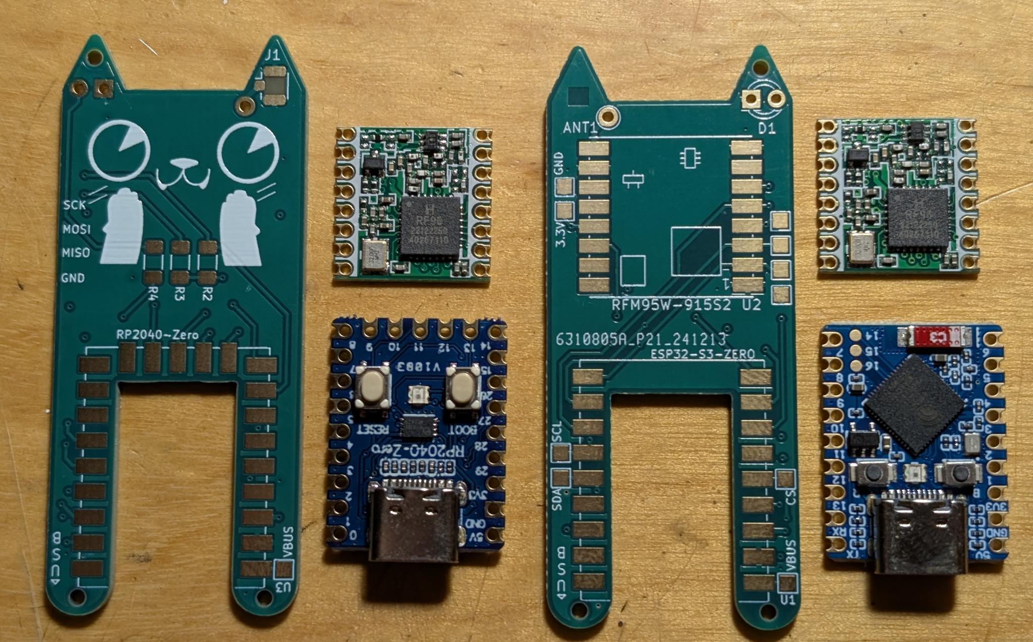
The Nibble - The Original Cat Meshtastic Node Kit
Make your own:
github.com/retiallc/nibble

Slide 29
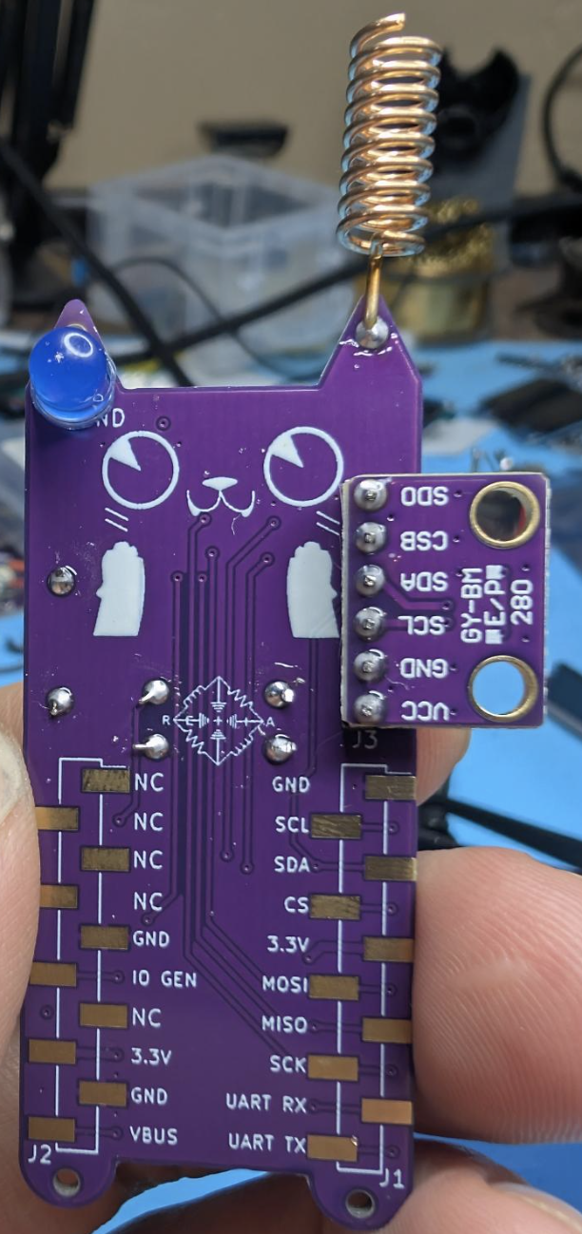
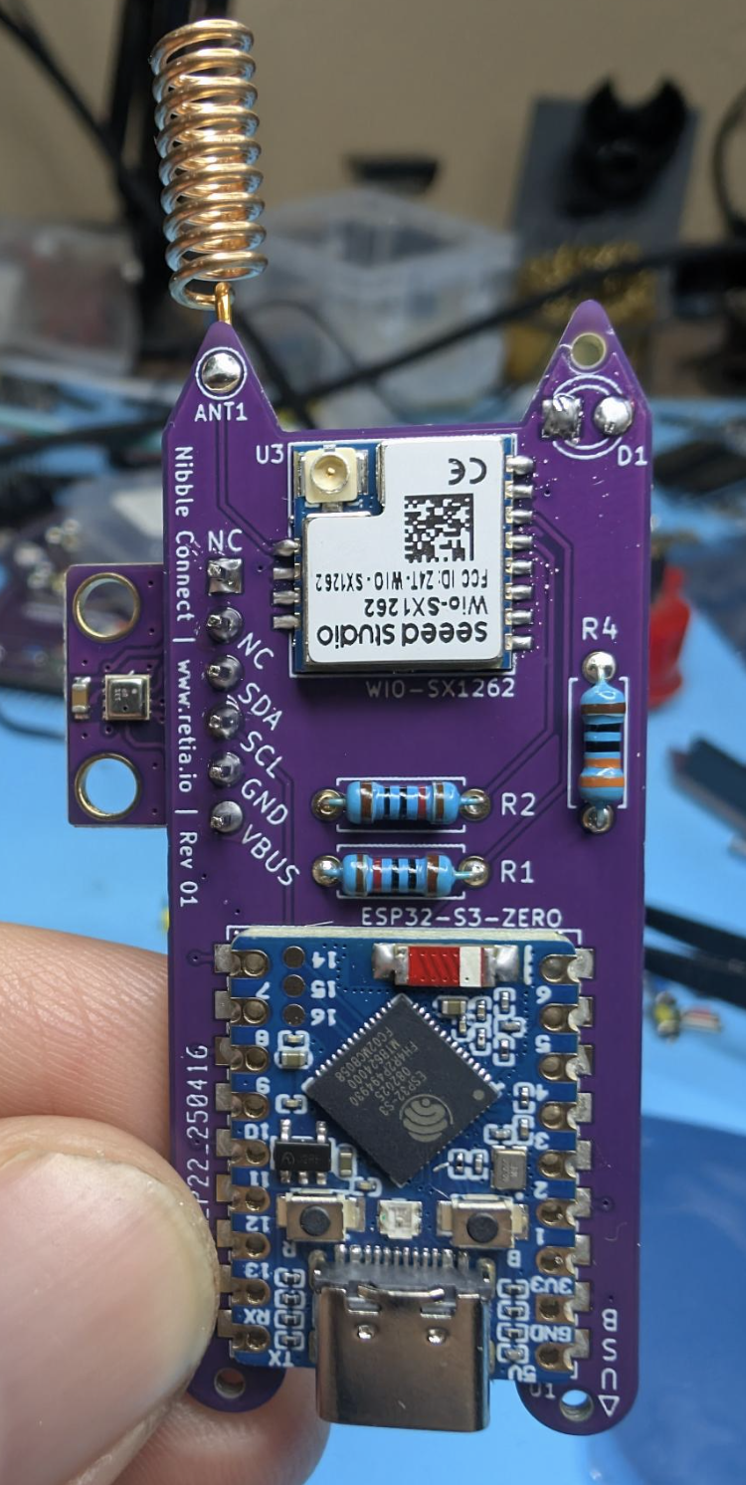
Update: The Nibble Connect
Based on feedback from C3, we created the Nibble Connect for our kids cyber camps:
Selected ESP32s3 Microcontroller (no more rp2040)
Upgraded to Seeed sx1262 LoRa Radio - software definable frequency & more sensitive
SMD Female Pin Headers (not very breadboard friendly)
Mount for BME280 weather station sensor

Slide 30
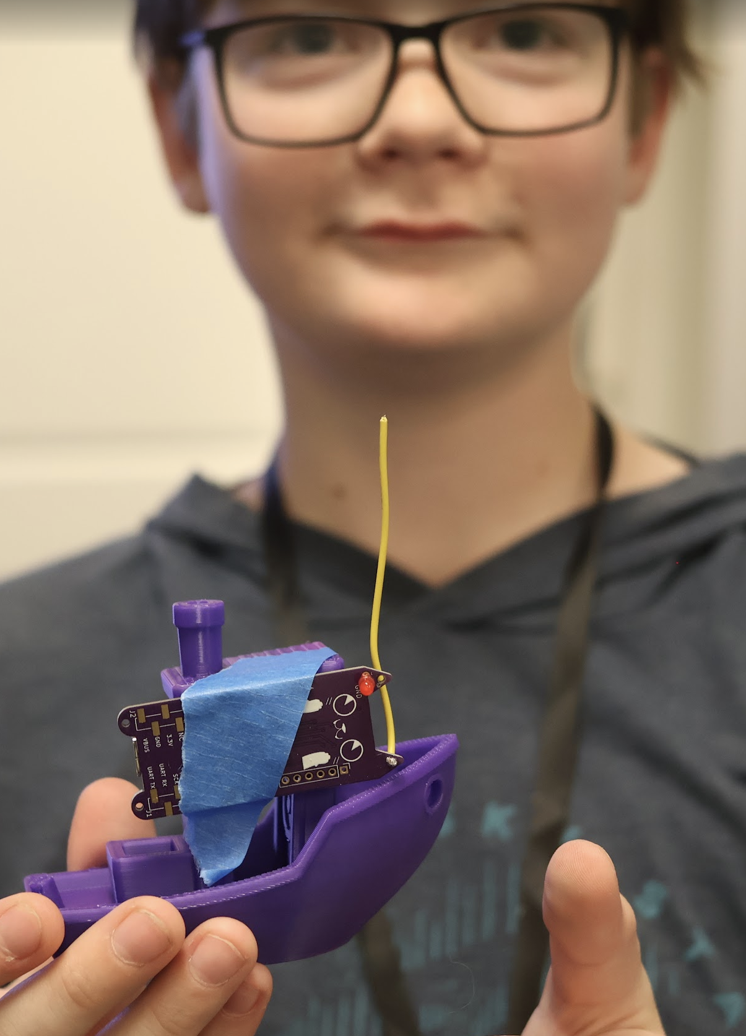
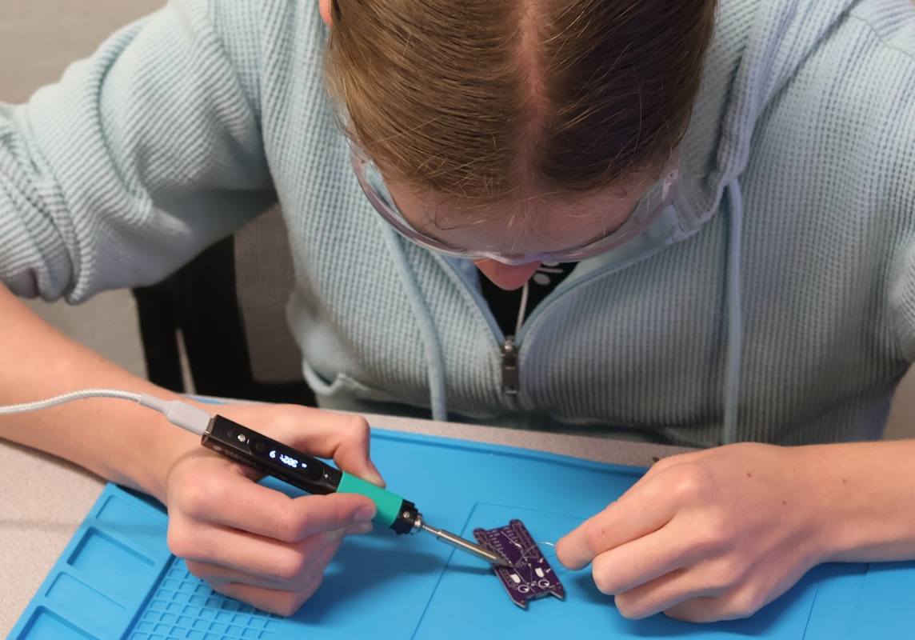
Update: The Nibble Connect

Slide 31
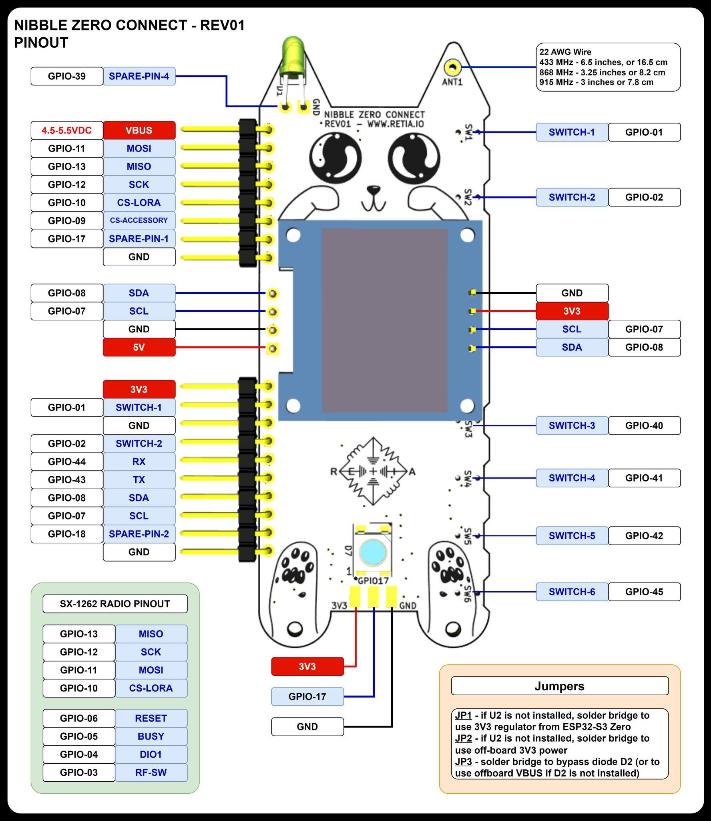
And Finally: Nibble Zero
What about a node that can use all the best features of Meshtastic & Meshcore, plus work with Flipper Zero?
Also uses ESP32s3 & sx1262 LoRa Radio
6 buttons for region select & sending canned messages
I2c mount for adding OLED screen
Flipper Zero and Breadboard compatible pin headers
Mount for BME280 weather station sensor
Neopixel tail

Slide 32
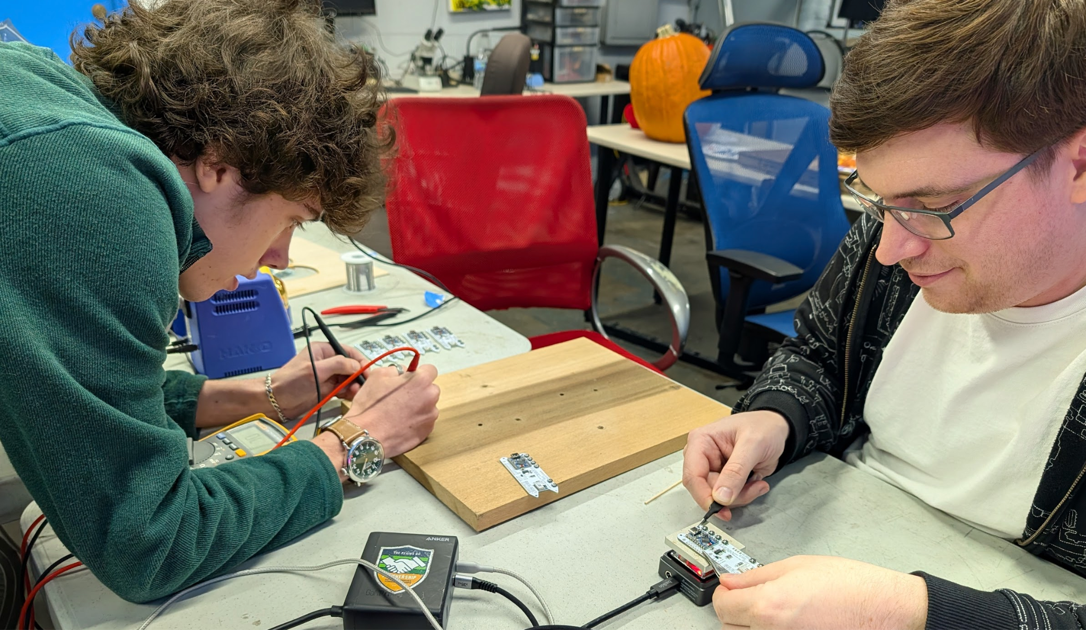
How did we make these?
13 friends and volunteers at Null Space Labs worked to create about 125 Nibbles for 39c3
3 software developers donated over 40 hours to get meshtastic, meshcore, & Reticulum working
13 helpers soldered for over 100 volunteer hours total
2 hardware designers tested & prototyped
Almost everyone was paid in hardware, pizza, or volunteered to build these for you!
We had to pay 120% tariff on everything

Slide 33
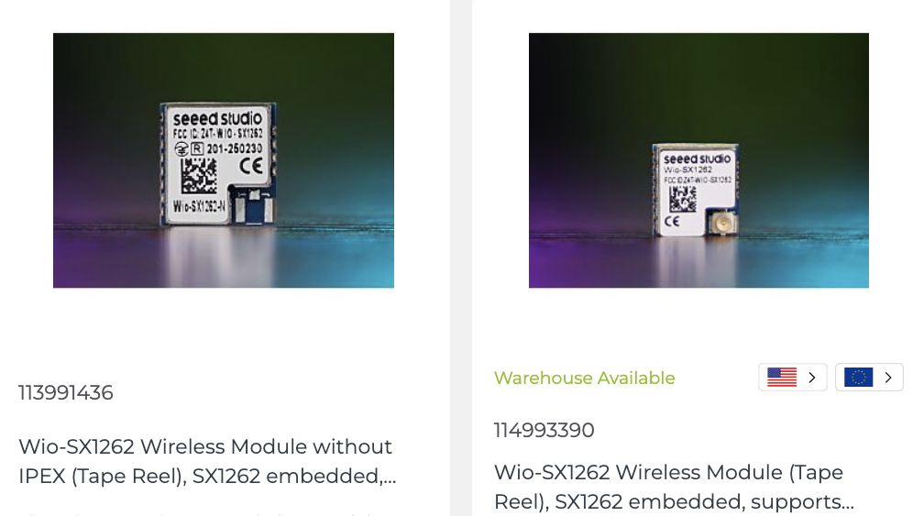
Different Radio Types, Different Antennas!!!
The radio without IPEX connector is ONLY connected via the antenna pin
The radio with IPEX connector is ONLY connected via the IPEX connector

Slide 34
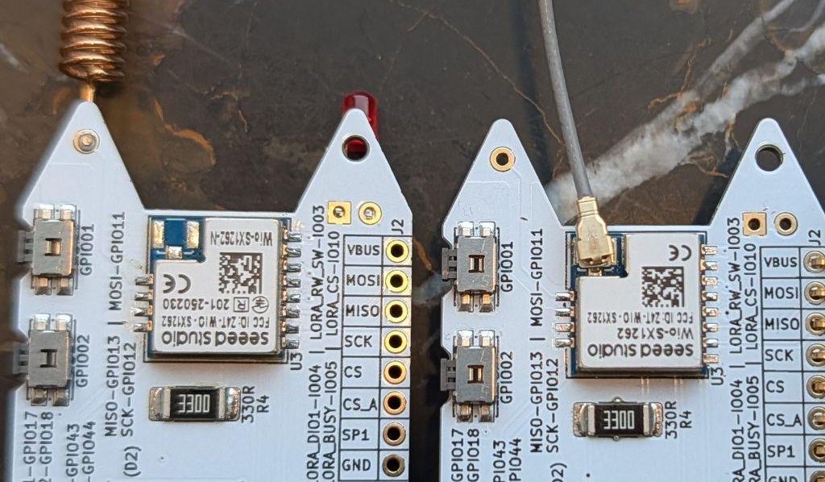
HOW TO ADD AN ANTENNA:
No IPEX? Connect antenna to the ANT1 pin, IPEX pad is disconnected
IPEX?
Connect antenna to the IPEX connector, ANT pin is disconnected

Slide 35

Let’s Flash Meshtastic - www.nugget.dev
In a Chrome based browser, open Nugget.dev

Slide 36

Update Via Chrome-Based Browser
Let’s Update!
Hold down the “B” button while plugging your Nibble into your computer via USB type C
Once plugged in, click “Connect your Nugget” and select your device.
If you’re not sure which it is, unplug and plug it back in to see it appear again.

Slide 37

Flashing is easy!
After selecting your Nibble from the drop down menu of serial devices,
Select the “Meshtastic For Nibble Zero”
Click program, unplug when complete!

Slide 38

Let’s Get Set Up With Meshtastic!
We’ll hand out antennas and get set up transmitting!

Slide 39

Check for Heartbeat
When you plug your Nibble back in, it should turn on the screen after 10 seconds
It will NOT transmit until you select the correct region, so let’s do that!
In a chrome based browser, go to https://client.meshtastic.org/

Slide 40


Connect Via Browser
Click on “New Connection” and select “Serial” from the menu of options.
You can also try Bluetooth here if you want.
Click “New device” and select your Nibble the same way you did to flash it.
It should appear, click it to enter the main menu!

Slide 41


Alt: Connect via Bluetooth with Smartphone App
Download the Meshtastic smartphone or Desktop app
Look for your node short name via Bluetooth
Pair using the pin that appears on the screen

Slide 42


Change Device Name
At the main menu, click “Change device name” and add a new name.
You can use emojis!
After you save, it will reboot with the new name.

Slide 43


Let’s Enable Our Radio!

Slide 44

Set Region - Web or Buttons
You can use the screen & buttons to set the region, or:
Click on Config, then LoRa.
Select the correct region and preset to MediumFast.
Also set the hop limit to 7.
Save, and your Nibble will reboot ready to transmit!

Slide 45


Paris: Mesh-IDF
https://wiki.mesh-idf.fr/fr/home
Uses Meshtastic Medium Fast
Very active!

Slide 46

We are transmitting!
Go to channel, primary channel, and type a message.
If you see “acknowledged,” another node has seen and retransmitted your message!

Slide 47



Let’s Explore Settings!

Slide 48


Device roles

Slide 49

What device roles mean
Surprise: changing to a router will turn off BLE!

Slide 50

Meshtastic LoRa Radio Profiles
8 Profiles: condense complex settings into common use cases
Trade-offs between long range or short range benefits (speed/range)
Often customized for conferences and events

Slide 51


Adding sensors & hardware
Temperature,motion, other sensors are easy!
Enable Telemetry module & add common i2c sensors!

Slide 52

I2C Sensors Supported

Slide 53

Modules (Part 1)

Slide 54

Modules (Part 2)

Slide 55

Enable Serial Module
Open the Nibble’s Serial Module in Meshtastic and apply these settings:
Enable Serial Module
Set Receive Pin to 44
Set Transmit Pin to 43
Set Baud Rate to 115200
Set “Mode” to “Textmsg”

Slide 56

Let’s Set Up For Our Flipper!
On your Flipper app, Download the UART Terminal app.
It’s usually included in Momentum and Unleashed firmware

Slide 57


Plug In And Power On
Plug your Nibble into your Flipper.
To power your Nibble:
Either plug in your Flipper to power, or go to the GPIO app and set “5V on GPIO” to “on”
If it won’t load, make sure you flashed the most recent firmware.

Slide 58


Open UART Terminal
Under Setup, make sure the baud rate is set to 115200
Select “Open Port” and hit the reset button (R) on your Nibble.
You should see serial output appear on the screen!
This means it’s set up correctly.

Slide 59



Send A Message
Select “Send Command”
Type out your message and hit “save”
Your message is sent! You should see it on other Meshtastic devices.

Slide 60

See Replies
Replies you receive will appear on the screen of your Flipper!

Slide 61
Want to go further?
https://github.com/cool4uma/UART_Terminal
Remote control app is open source, you can improve and refine it for whatever use case you want!

Slide 62


Meshtastic Alternatives
Meshcore - Routes more like Tor, does not use flood routing and establishes circuits for DM’s. Uses less bandwidth for communication.
Reticulum - A cryptography-based networking stack for building local and wide-area networks with readily available hardware, including Wi-Fi and LoRa

Slide 63

Let’s Set Up Meshcore
In Paris, Meshcore is finding more and more use!
Let’s set up Meshcore and join!
Download the MeshCore app for your smartphone

Slide 64

Flash on Nugget.dev
Flashing is the same process as before on Nugget.dev
Hold down the “B” button of your Nibble while plugging in
On Nugget.dev from a chrome browser, click “Connect your Nugget” and select your device from the drop-down menu
Select “Nibble Zero Meshcore Companion” from the firmware list
Click “Program” and unplug when your device is done flashing.

Slide 65

Plug In Your Device & Connect
Plug in your flashed device
It will start up and show a bluetooth pairing PIN
Connect to your device on your smartphone or https://app.meshcore.nz/

Slide 66

Pair Via Bluetooth & Open Settings
On https://app.meshcore.nz/ or the app, select your device and pair using the bluetooth pin. **YOU MAY NEED TO FORGET THE DEVICE IN BLUETOOTH SETTINGS FOR THIS TO WORK**
Click the gear icon for settings

Slide 67

Connect To Gaulix

Slide 68


Connect To Gaulix
Set your radio settings:

Slide 69


Hit Save, Advertise, & Say Hi!
Click the “Advert - Flood Routed” to advertise your node to other devices in the area! You’ll automatically add contacts you see.
Try sending a message in the public chat!

Slide 70


Meshcore Tools To Explore: Trace Path
Trace a route between nodes using a map or text interface

Slide 71


Meshcore Tools To Explore: Line of Sight
Check line of sight between node locations
Also see all received messages in RX log!

Slide 72

Meshcore Repeater
Want to flash a Meshcore Repeater?
Put your Nibble into boot mode and visit Nugget.dev
Erase your device, select the Nibble Meshcore Repeater & flash
Unplug your device and plug it back in, then go to:
https://flasher.meshcore.co.uk/

Slide 73
Set Up Repeater
Plug in your Nibble, and then select “Repeater Setup” On: https://flasher.meshcore.co.uk/
Set the name and password
Change the radio settings to: EU/UK Narrow Preset
Frequenz: 869.618 MHz
Bandbreite: 62.5
Spreading Factor: 8
Coding Rate: 8
Save, and click “Send Advert”

Slide 74

Configure Remotely Via Password
You can connect to your repeater via the password you set from another Meshtastic companion node.
Find the repeater in your contacts and select “Manage”.
Enter the password you set and you’ll be able to access settings.

Slide 75

Join Regional Mesh Nets!
Start advertising and transmitting, you should see repeaters start to appear.
Find settings on: https://www.meshcore.fr/

Slide 76


France: Gaulix
https://gaulix.fr/
Very long range
Highly coordinated

Slide 77

Teach a friend!
We have kits on Retia.io and discounts for instructors teaching classes!
Nuggets
Add-ons
Online classes

Slide 78

Keep in Touch
Want to learn more? You can find us here:
Discord: https://discord.gg/rjVJbauAUX
Store: Retia.io
Nugget Flasher: Nugget.dev
My work: www.hack.gay

